Slide 1
Processing Aggregate Queries in a Federation of SPARQL Endpoints
Dilshod IBRAGIMOV, KATJA HOSE, TORBEN BACH PEDERSEN, ESTEBAN ZIMÁNYI.

Slide 2
Motivating Example
Earthquake in the Pacific in March 2011 tsunami a nuclear accident
Hourly observation of radioactivity statistics at 47 prefectures
Observations (March 16, 2011 – March 15, 2012) converted to RDF data (places represented by URI from GeoNames)
Interesting analyses:
AVG radioactivity separately for each prefecture in Japan
The MIN and MAX radioactivity for each prefecture (changes within one-year observations)

Slide 3
Motivating Example - Observation

Slide 4
Motivating Example - Query
Ex: Show average radioactivity values for each prefecture
SELECT ?regName ( AVG (?floatRV ) AS ?average ) WHERE {
?s ev:place ?placeID . ?s ev:time ?time . ?s rdf:value ?radioValue .
SERVICE <http://lod2.openlinksw.com/sparql> {
?placeID gn:parentFeature ?regionID . ?regionID gn:name ?regName .
}
BIND (xsd:float (?radioValue ) as ?floatRV ) .
}
GROUP BY ?regName

Slide 5
Motivating Example - Results
Virtuoso v07.10.3207, Sesame v2.7.11, and Jena Fuseki v1.0.0 (based on ARQ) timed out
Network traffic analyzer showed that:
Virtuoso and Fuseki query GeoNames for each radioactivity observation (more than 400,000 requests)
Sesame is trying to download all triples that match the SERVICE query pattern (more than 7.8 million triples)

Slide 6
Outline
Basic Strategies
CODA
Test Case
Conclusion and Future Works

Slide 7
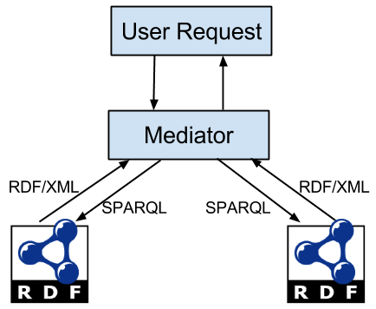
Basic Strategies - Mediator Join
The mediator/federator receives the query from the user
The query optimizer sends separate queries to endpoints
and merges the results
Strong point – parallelization
Weak point – expensive for large intermediate
results/datasets

Slide 8
Basic Strategies - Semi-Join
Main principle is to execute the subquery with the smallest result first and use the retrieved results as bindings for the join variable in other subqueries (SPARQL structure)
Efficient for highly selective subqueries (with FILTER statement)
SELECT ?regName ( AVG (?radioValue ) AS ?average ) WHERE {
?s ev:place ?placeID . ?s ev:time ?time . ?s rdf:value ?radioValue .
SERVICE <http://lod2.openlinksw.com/sparql> {
?placeID gn: parentFeature ?regionID . ?regionID gn:name ?regName .
}
FILTER(?radioValue < 0.08) .
} GROUP BY ?regName

Slide 9
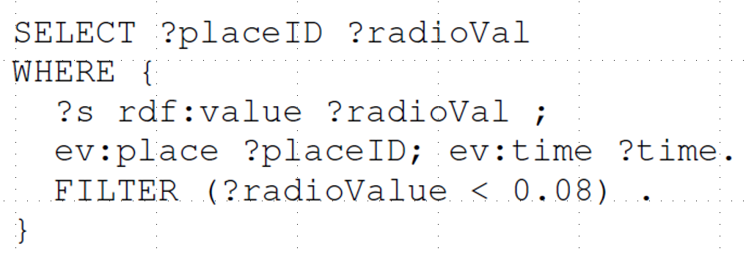
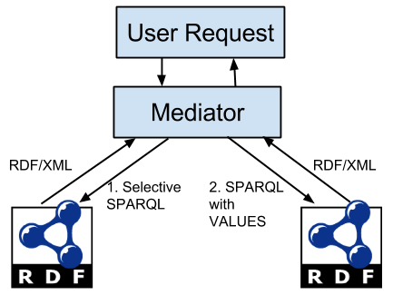
Basic Strategies - Semi-Join (Cont)
Weak point - VALUES is not yet widely adopted in existing endpoints. SPARQL 1.0 compliant alternatives of UNION (or FILTER) must often be used

Slide 10
Basic Strategies - Partial Aggregation
If results are grouped by SERVICE query variables, further optimization is possible (motivating query example)
1) First group by the observation place (?placeID)
SELECT ?placeID (SUM (?floatRV ) AS ?avgSUM) (COUNT (?floatRV ) AS ?avgCNT ) WHERE {
?s ev:place ?placeID . ?s ev:time ? time . ?s rdf:value ? radioValue .
BIND (xsd:float (?radioValue ) as ?floatRV ) .
}
GROUP BY ?placeID

Slide 11
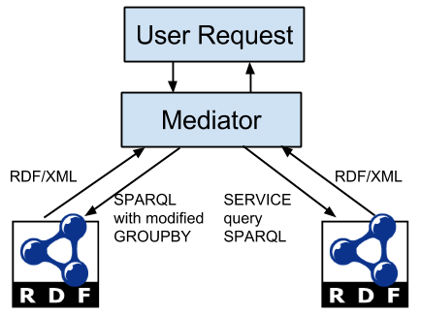
Basic Strategies - Partial Aggregation (Cont)
Then execute SERVICE query
SELECT ?placeID ?regName WHERE {
?placeID gn:parentFeature ?regionID .
?regionID gn:name ?regName .
VALUES (?placeID) {
(<http://sws.geonames.org/1852083/>) ….
}
}
Final step – join the intermediate results and compute the final result (distributed/algebraic functions)

Slide 12
CODA – Cost-based Optimizer for Distributed Aggregate Queries
Decomposes the original query into multiple subqueries (query $Q_{M}$ and SERVICE queries $Q_{e1}$ … $Q_{eN}$)
Estimates query execution costs for different query execution plans
Chooses the one with minimum costs

Slide 13
CODA - Costs
Overall costs $C_{Q}$
$C_{Q}= C_{P}+C_{C}$
Communication costs $C_{C}$ for subquery $S_{i}$:
$C_{C}\left(S_{i}\right)= C_{O}+c_{S_{i}} ∗ C_{map}$ ; $C_{O}$ - communication establishing overhead , $c_{S_{i}}$ - result size, and $C_{map}$ - single result transfer cost
Processing costs
$C_{P}=c_{{agg}_{i}}∗C_{AGG}$ ; $c_{{agg}_{i}}$ - number of aggregated observations, $C_{AGG}$ - cost for processing a single observation

Slide 14
CODA - Estimating Constants
$C_{map}$ - estimated using “SELECT * WHERE { ?s #p ?o . FILTER(?o = #o) } LIMIT #L”; different values for #L, #o and #p
$C_{O}$ - estimated with multiple “ASK {}” or “SELECT (1 AS ?v) {}”
$C_{AGG}$ - estimated based on multiple “SELECT COUNT(?s) WHERE {?s ?p ?o } GROUP BY ?o”
Not perfectly accurate but the aim is to find out which execution plan is more efficient (not to predict the execution costs)

Slide 15
CODA - Result Size Estimation
Result size estimation - VoID statistics (dataset, property partition, class partition)
$c_{t}$ - total number of triples (void:triples), $c_{s}$- total number of distinct subjects (void:distinctSubjects), $c_{o}$ - total number of distinct objects (void:distinctObjects)
Single patterns - $C_{res}$ for (?s ?p ?o) is given by $c_{t}$, (s ?p ?o) estimated as $c_{t}$/$c_{s}$, (?s ?p o) as $c_{t}$/$c_{o}$, and (s ?p o) as $c_{t}$/${(c}_{s}∗c_{o})$; FILTER influence estimates
Joins - estimates depend on shape (star vs path). Formulas taken from “Resource Planning for SPARQL Query Execution on Data Sharing Platforms”.

Slide 16
CODA – Motivating Example
Decomposed into 3 queries
SELECT ?placeID (AVG(?floatRV) AS ?average) WHERE
{
?s ev:place ?placeID .
?s rdf:value ?radioValue .
BIND(xsd:float(?radioValue) AS ?floatRV) .
?s ev:time ?time .
}
GROUP BY ?placeID
SELECT ?placeID ?floatRV
WHERE
{
?s ev:place ?placeID .
?s rdf:value ?radioValue .
BIND(xsd:float(?radioValue) AS ?floatRV) .
?s ev:time ?time .
}
SELECT ?placeID ?regName
WHERE
{
?placeID gn:parentFeature ?regionID .
?regionID gn:name ?regName .
}

Slide 17
CODA – Motivating Example
Estimates for Radioact query:
number of aggregated triples: 405384
estimated cost: 15
number of returned triples: 405384
estimated cost: 129
Estimates for GeoNames query:
number of returned triples: 7877627
estimated cost: 1956
Selected plan – Partial Aggregation

Slide 18
Test Case – SSB as RDF
Star Schema Benchmark converted to RDF (strongly resembling SSB tabular structure)
We generated data for different scale factors (1 to 5 - 6M to 30M observations, 110,5M to 547,5M triples)
Different configurations
two endpoints (one endpoint containing main observation data and one SERVICE endpoint containing supporting data)
three endpoints (two SERVICE endpoints containing supporting data)
four endpoints (three SERVICE endpoints containing supporting data)
All datasets and queries are available at http://extbi.cs.aau.dk/coda/

Slide 19
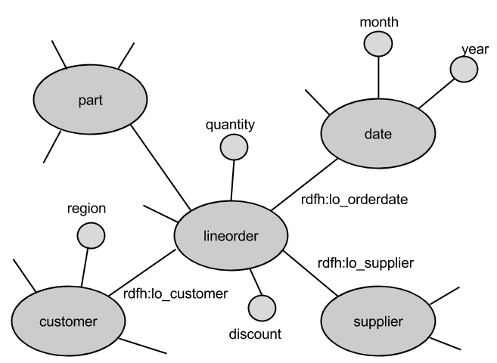
SSB RDF schema (partial)

Slide 20
Test Case – SSB Queries

Slide 21
Test Case – Results (One SERVICE Endpoint)

Slide 22
Test Case – Results (One SERVICE Endpoint Q2.3)

Slide 23
Test Case – Results (One to Three SERVICE Endpoints Q4.3)

Slide 24
Conclusion and Future Work
Efficiently processing aggregate queries in a federation of SPARQL endpoints
Processing strategies (MedJoin, SemiJoin, PartialAgg)
Cost-based Optimizer for Distributed Aggregate queries (CODA)
efficient and scalable
chooses the best query processing plan in different situations
significantly outperforms current state-of-the art triple stores
Future Work:
Using more complex statistics with precomputed join result sizes and correlation information for better cardinality estimation
Optimizing more complex queries, e.g., with optional patterns or complex aggregation functions

