Slide 1
Optimizing Aggregate SPARQL Queries using Materialized RDF Views
Dilshod IBRAGIMOV, KATJA HOSE, TORBEN BACH PEDERSEN, ESTEBAN ZIMÁNYI.

Slide 2
Motivation
Problems with relational systems
No support for triples with blank nodes
No support for entailment
Poor support for the graph-structured RDF model
Performing aggregate queries on large graphs – costly, (RDF specifics)

Slide 3
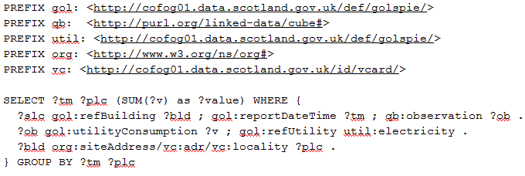
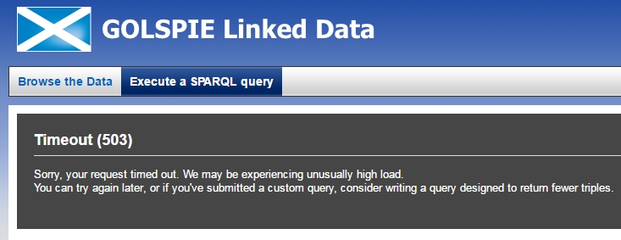
Motivation
Analytical queries are responsible for high load in SPARQL endpoints – they often time out http://cofog01.data.scotland.gov.uk/sparql
Need special techniques to speed up execution, like materialized views

Slide 4
MARVEL – Materialized RDF Views with Entailment and incompLetness
Speed up the analytical SPARQL queries by using materialized views
A SPARQL syntax for defining aggregate views
Cost model to select RDF views for materialization
An algorithm for rewriting SPARQL aggregate queries using these views

Slide 5
Analytical SPARQL Queries
Graphical representation of the example query
Notes:
Talk about rooted BGP, multidimensional data and OLAP operations. Also used to explain algorithms

Slide 6
Creating Materialized Views
Aggregation – summarized data in tabular format
Need to create new triples to store it as RDF
Use CONSTRUCT query
New IRI for generated triples - grouping combination - creating unique IRI

Slide 7
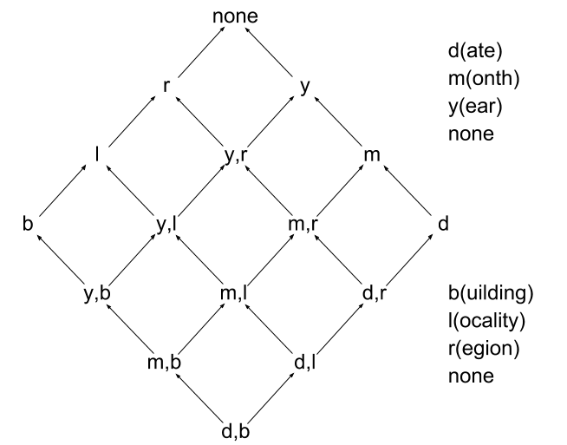
RDF Cube Lattice
Dependencies between views
Views for evaluating user queries
Incomplete views, complex and indirect hierarchies
View materialization - deriving implicit information (complete answer)
Using extended QB4OLAP vocabulary

Slide 8
Cost Model – Calculating View Benefit
Goal - select N views with highest benefit
Benefit of view w relative to v :
$B_{w,v}=Cost\left(v\right)−Size\left(w\right)$ if $Cost\left(v\right)>Size(w)$
$B_{w,v}=0$ otherwise
Number of triples in an observation:
$\left(n+m\right),$ n - # of dimensions, m - # of measures
Size of a view w:
$Size\left(w\right)=\left(n+m\right)∗K$, K - # of observations
If v is computed from w:
Cost(v) = Size(w)
Total benefit of view w:
$B_{w}= \sum{B_{w,v_{i}}}$

Slide 9
Algorithm for Selecting Views for Materialization
$A−all views$ in cube lattice
S = {empty} – selected views
While Size(S) < N
$RecalculateViewCost(A)$
$ForEach v ∈ A Calculate benefit B\left(v\right)$
$ForEach \left\{v_{1}^{inc}…v_{n}^{inc}\right\} ∈ A Calculate benefit B\{v_{1}^{inc}…v_{n}^{inc}\}$
$Select v (or \left\{v_{1}^{inc}…v_{n}^{inc}\right\}) for which B\left(v\right)is MAX and Size\left(S union v\right)<N$
$S=S union v$
$End$

Slide 10
Algorithm for Selecting Views for Materialization
$A−all views$ in cube lattice
S = {empty} – selected views
While Size(S) < N
$RecalculateViewCost(A)$
$ForEach v ∈ A Calculate benefit B\left(v\right)$
$ForEach \left\{v_{1}^{inc}…v_{n}^{inc}\right\} ∈ A Calculate benefit B\{v_{1}^{inc}…v_{n}^{inc}\}$
$Select v (or \left\{v_{1}^{inc}…v_{n}^{inc}\right\}) for which B\left(v\right)is MAX and Size\left(S union v\right)<N$
$S=S union v$
$End$

Slide 11
Algorithm for Selecting Views for Materialization

Slide 12
Algorithm for Selecting Views for Materialization
$A−all views$ in cube lattice
S = {empty} – selected views
While Size(S) < N
$RecalculateViewCost(A)$
$ForEach v ∈ A Calculate benefit B\left(v\right)$
$ForEach \left\{v_{1}^{inc}…v_{n}^{inc}\right\} ∈ A Calculate benefit B\{v_{1}^{inc}…v_{n}^{inc}\}$
$Select v (or \left\{v_{1}^{inc}…v_{n}^{inc}\right\}) for which B\left(v\right)is MAX and Size\left(S union v\right)<N$
$S=S union v$
$End$

Slide 13
Algorithm for Selecting Views for Materialization

Slide 14
Algorithm for Selecting Views for Materialization
$A−all views$ in cube lattice
S = {empty} – selected views
While Size(S) < N
$RecalculateViewCost(A)$
$ForEach v ∈ A Calculate benefit B\left(v\right)$
$ForEach \left\{v_{1}^{inc}…v_{n}^{inc}\right\} ∈ A Calculate benefit B\{v_{1}^{inc}…v_{n}^{inc}\}$
$Select v (or \left\{v_{1}^{inc}…v_{n}^{inc}\right\}) for which B\left(v\right)is MAX and Size\left(S union v\right)<N$
$S=S union v$
$End$

Slide 15
Algorithm for Selecting Views for Materialization

Slide 16
Algorithm for Selecting Views for Materialization
$A−all views$ in cube lattice
S = {empty} – selected views
While Size(S) < N
$RecalculateViewCost(A)$
$ForEach v ∈ A Calculate benefit B\left(v\right)$
$ForEach \left\{v_{1}^{inc}…v_{n}^{inc}\right\} ∈ A Calculate benefit B\{v_{1}^{inc}…v_{n}^{inc}\}$
$Select v (or \left\{v_{1}^{inc}…v_{n}^{inc}\right\}) for which B\left(v\right)is MAX and Size\left(S union v\right)<N$
$S=S union v$
$End$

Slide 17
Algorithm for Selecting Views for Materialization

Slide 18
Algorithm for Selecting Candidate View
$Q−user query$
S = {empty} – candidate views
$ForEach v ∈$ S
$\left\{d_{1}^{v}…d_{n}^{v}\right\}=FindMinimalRollUpPaths(v)$
$\left\{d_{1}^{Q}…d_{m}^{Q}\right\}=FindMinimalRollUpPaths(Q)$
$If \left\{d_{1}^{Q}…d_{m}^{Q}\right\} ≼\left\{d_{1}^{v}…d_{n}^{v}\right\} and f_{agg}^{Q} ⊆ f_{agg}^{v}$
$S=S union v$
$Select view w ∈S with minimal cost$

Slide 19
Algorithm for Selecting Candidate View – Query
Show energy consumption grouped by region in 2016

Slide 20
Algorithm for Selecting Candidate View – View
Materializing view grouped by city and month
SELECTQuery
View

Slide 21
Algorithm for Selecting Candidate View
$Q−user query$
S = {empty} – candidate views
$ForEach v ∈$ S
$\left\{d_{1}^{v}…d_{n}^{v}\right\}=FindMinimalRollUpPaths(v)$
$\left\{d_{1}^{Q}…d_{m}^{Q}\right\}=FindMinimalRollUpPaths(Q)$
$If \left\{d_{1}^{Q}…d_{m}^{Q}\right\} ≼\left\{d_{1}^{v}…d_{n}^{v}\right\} and f_{agg}^{Q} ⊆ f_{agg}^{v}$
$S=S union v$
$Select view w ∈S with minimal cost$

Slide 22
Algorithm for Selecting Candidate View

Slide 23
Algorithm for Selecting Candidate View
$Q−user query$
S = {empty} – candidate views
$ForEach v ∈$ S
$\left\{d_{1}^{v}…d_{n}^{v}\right\}=FindMinimalRollUpPaths(v)$
$\left\{d_{1}^{Q}…d_{m}^{Q}\right\}=FindMinimalRollUpPaths(Q)$
$If \left\{d_{1}^{Q}…d_{m}^{Q}\right\} ≼\left\{d_{1}^{v}…d_{n}^{v}\right\} and f_{agg}^{Q} ⊆ f_{agg}^{v}$
$S=S union v$
$Select view w ∈S with minimal cost$

Slide 24
Algorithm for Selecting Candidate View

Slide 25
Algorithm for Selecting Candidate View
$Q−user query$
S = {empty} – candidate views
$ForEach v ∈$ S
$\left\{d_{1}^{v}…d_{n}^{v}\right\}=FindMinimalRollUpPaths(v)$
$\left\{d_{1}^{Q}…d_{m}^{Q}\right\}=FindMinimalRollUpPaths(Q)$
$If \left\{d_{1}^{Q}…d_{m}^{Q}\right\} ≼\left\{d_{1}^{v}…d_{n}^{v}\right\} and f_{agg}^{Q} ⊆ f_{agg}^{v}$
$S=S union v$
$Select view w ∈S with minimal cost$

Slide 26
Algorithm for Selecting Candidate View
View
User Query

Slide 27
Query Rewriting Algorithm
Replacing user query over data using view
User Query
Rewritten Query

Slide 28
Evaluation
Benchmark data generators – no option to generate required data
Adapted data generators for 2 different datasets. Generated data for three scale factors (mln triples):
64-bit Ubuntu 14.04 LTS with CPU Intel(R) Core(TM)i7-950, 24GB RAM, 600GB HDD; Virtuoso v07.10.3207; dotNetRDF
Executed 5 times after a single warm-up run; average runtime reported
 | SF1 | SF2 | SF3
LUBM | 5M | 15M | 33M
SSB | 104M | 191M | 277M

Slide 29
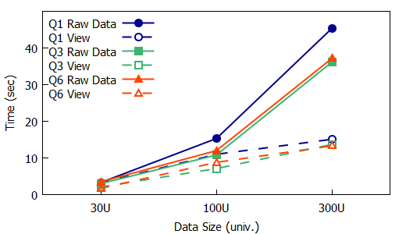
Comparing Queries in Adapted LUBM
Performance gain is more evident with the growth in the volume of data

Slide 30
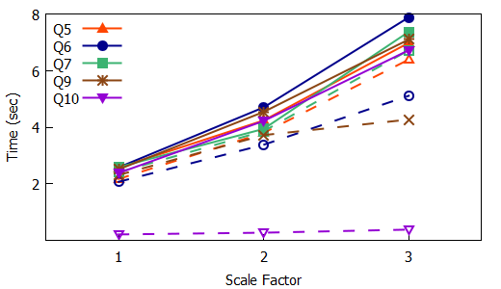
Comparing Queries in Adapted SSB
With MARVEL, execution of queries is on average 5 times faster (up to 18 times for some queries)

Slide 31
Evaluation – Entailment
Materialized views with and without entailment
MARVEL is 1.7 times faster for views with entailment

Slide 32
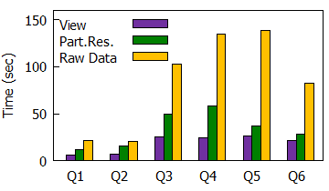
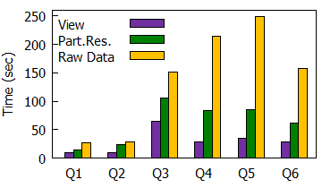
Comparing with Partial Materialization Approach
Partial results of user queries to answer subsequent queries
MARVEL on average more than twice as fast as partial result materialization
Slice
Dice
Roll-up

Slide 33
Conclusion and Future Work
MARVEL – designed for efficiently executing aggregate queries using views
Cost model for selecting views with most benefit
A SPARQL syntax for defining aggregate views
An algorithm for rewriting SPARQL aggregate queries using views
3-10 times speedup for aggregate queries
Future Work:
Algorithms for incrementally maintaining materialized views
http://extbi.cs.aau.dk/aggview/

Slide 34
Questions?

